Slide 1
ALGORITHMS, FLOWCHARTS, AND PSEUDOCODE
L-9

Slide 2
ALGORITHMS AND FLOWCHARTS
A typical programming task can be divided into two phases:
Problem solving phase
produce an ordered sequence of steps that describe solution of problem
this sequence of steps is called an algorithm
Implementation phase
implement the program in some programming language

Slide 3
Steps in Problem Solving
First produce a general algorithm (one can use pseudocode)
Refine the algorithm successively to get step by step detailed algorithm that is very close to a computer language.
Pseudocode is an artificial and informal language that helps programmers develop algorithms. Pseudocode is very similar to everyday English.

Slide 4
ALGORITHMS
The term algorithm originally referred to any computation performed via a set of rules applied to numbers written in decimal form.
Invented by an Arabic mathematician Abu Ja'far Mohammed ibn Musa al-Khowarizmi
rules for performing the four basic arithmetic operations (addition, subtraction, multiplication and division) on decimal numbers.
An algorithm is a representation of a solution to a problem with defined procedure
A procedure is a finite sequence of well-defined instructions, each of which can be mechanically carried out in a finite amount of time.

Slide 5
ALGORITHMS
An algorithm is a procedure consisting of a finite set of unambiguous rules (instructions) which specify a finite sequence of operations that provides the solution to a problem, or to a specific class of problems for any allowable set of input quantities (if there are inputs).
In other word, an algorithm is a step-by-step procedure to solve a given Problem.
we can define an algorithm as a set or list of instructions for carrying out some process step by step

Slide 6
ALGORITHMS
One of the obstacles to overcome in using a computer to solve your problems is that of translating the idea of the algorithm to computer code (program).
In the problem-solving phase of computer programming, you will be designing algorithms.
This means that you will have to be conscious of the strategies you use to solve problems in order to apply them to programming problems.
These algorithms can be designed through the use of flowcharts or pseudocode.

Slide 7
FLOWCHARTS
Flowcharting is a tool developed in the computer industry, for showing the steps involved in a process.
Or
A flowchart is a diagram made up of boxes, diamonds and other shapes, connected by arrows - each shape represents a step in the process, and the arrows show the order in which they occur.

Slide 8
A Flow Chart -A graphical representation of the sequence of operations in an information system or program.
Information system flowcharts show how data flows from source documents through the computer to final distribution to users.
Program flowcharts show the sequence of instructions in a single program or subroutine.
A Flowchart
shows logic of an algorithm
emphasizes individual steps and their interconnections
e.g. control flow from one action to the next

Slide 9
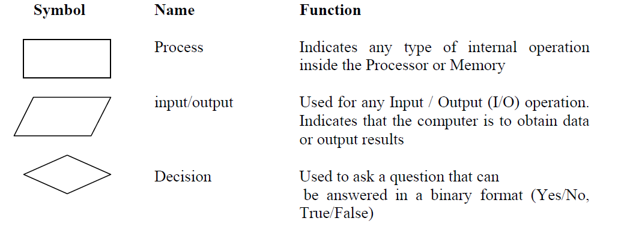
Flowcharting Symbols
There are 6 basic symbols commonly used in flowcharting of assembly language programs

Slide 10
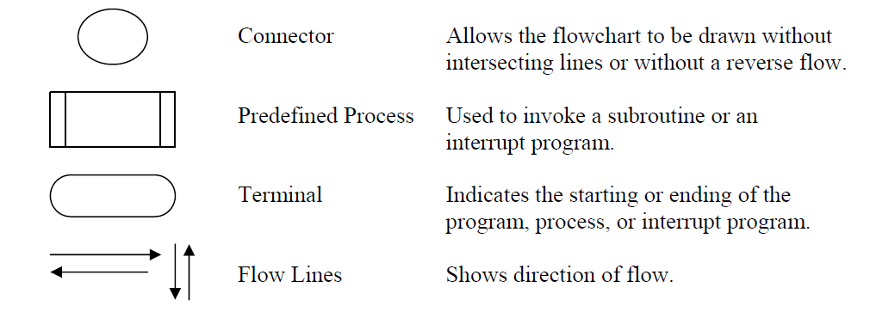

Slide 11
General Rules for flowcharting
1. All boxes of the flowchart are connected with Arrows. (Not lines)
2. Flowchart symbols have an entry point on the top of the symbol with no other entry points.
The exit point for all flowchart symbols is on the bottom except for the Decision symbol.
3. The Decision symbol has two exit points; these can be on the sides or the bottom and one side.
4. Generally a flowchart will flow from top to bottom.
However, an upward flow can be shown as long as it does not exceed 3 symbols.

Slide 12
5. Connectors are used to connect breaks in the flowchart. Examples are:
• From one page to another page.
• From the bottom of the page to the top of the same page.
• An upward flow of more than 3 symbols
6. Subroutines and Interrupt programs have their own and independent flowcharts.
7. All flow charts start with a Terminal or Predefined Process (for interrupt programs or subroutines) symbol.
8. All flowcharts end with a terminal or a contentious loop.

Slide 13
Examples of Algorithms and Flowcharts
Example 1. Design an algorithm and the corresponding flowchart for adding the test scores as given below:
26, 49, 98, 87, 62, 75

Slide 14
a) Algorithm
1. Start
2. Sum = 0
3. Get the first testscore
4. Add first testscore to sum
5. Get the second testscore
6. Add to sum
7. Get the third testscore
8. Add to sum
9. Get the Forth testscore
10. Add to sum
11. Get the fifth testscore
12. Add to sum
13. Get the sixth testscore
14. Add to sum
15. Output the sum
16. Stop

Slide 15
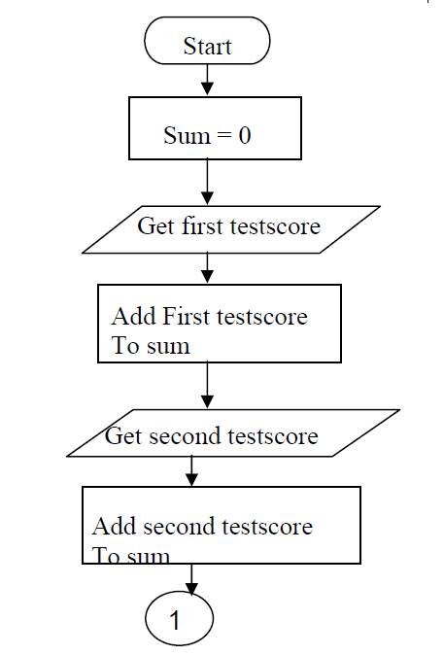
The corresponding flowchart is as follows:

Slide 16
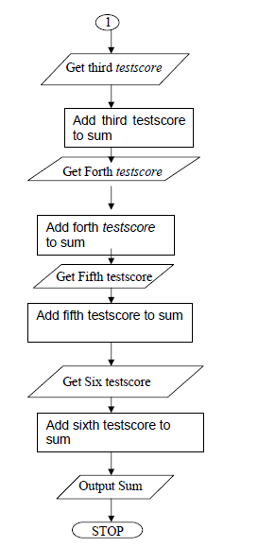

Slide 17
One could shorten the algorithm or flowchart as follows:
1. Start
2. Sum = 0
3. Get a value
4. sum = sum + value
5. Go to step 3 to get next Value, until all no are done
6. Output the sum
7. Stop

Slide 18
PSEUDOCODE
Pseudocode is one of the tools that can be used to write a preliminary plan that can be developed into a computer program.
Or
Pseudocode is a generic way of describing an algorithm without use of any specific programming language syntax.

Slide 19
This is the pseudo-code required to input three numbers from the keyboard output the result.
Use variables: sum, number1, number2, number3 of type integer
Accept number1, number2, number3
Sum = number1 + number2 + number3
Print sum
End program

Slide 20
Pseudocode & Algorithm
Example 2: Write an algorithm to determine a student’s final grade and indicate whether it is passing or failing. The final grade is calculated as the average of four marks.

Slide 21
Pseudocode & Algorithm
Pseudocode:
Input a set of 4 marks
Calculate their average by summing and dividing by 4
if average is below 50
Print “FAIL”
else
Print “PASS”

Slide 22
Pseudocode & Algorithm
Detailed Algorithm
Step 1: Input M1,M2,M3,M4
Step 2: GRADE ← (M1+M2+M3+M4)/4
Step 3: if (GRADE < 50) then
Print “FAIL”
else
Print “PASS”
endif

Slide 23
CONTROL STRUCTURES OR LOGICAL STRUCTURES
The key to better algorithm design and thus to programming lies in limiting the control structure to only three constructs. These are illustrated below:
The sequence structure(The sequence structure is a case where the steps in an algorithm are constructed in such a way that, no condition step is required.)
Decision Structure or Selection Structure(one has to make a choice of two alternatives by making decision depending on a given condition.)
Repetition or Iteration Structure; causes the certain steps to be repeated.

Slide 24
The sequence structure
For example, suppose you are required to design an algorithm for finding the average of six numbers, and the sum of the numbers is given.
The pseudocode will be as follows
Start
Get the sum
Average = sum / 6
Output the average
Stop

Slide 25
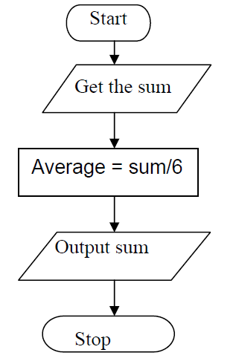
The corresponding
flowchart will appear as follows:

Slide 26
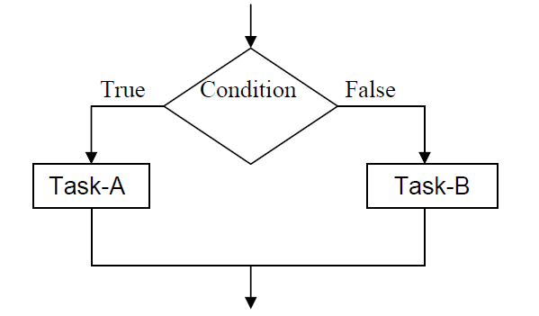
Decision Structure or Selection Structure
Selection structures are also called case selection structures when there are two or more alternatives to choose from.
In pseudocode form we get
If condition is true
Then do task A
Else
Do Task-B

Slide 27
Example
Write an algorithm that reads two values, determines the largest value and prints the largest value with an identifying message.
ALGORITHM
Step 1: Input VALUE1, VALUE2
Step 2: if (VALUE1 > VALUE2) then
MAX ← VALUE1
else
MAX ← VALUE2
endif
Step 3: Print “The largest value is”, MAX

Slide 28
Example. flowchart
START
Input
VALUE1,VALUE2
Y
is
VALUE1>VALUE2
N
MAX ← VALUE1
MAX ← VALUE2
Print
“The largest value is”, MAX
STOP

Slide 29
NESTED IFS
One of the alternatives within an IF–THEN–ELSE statement
may involve further IF–THEN–ELSE statement

Slide 30
Example
Write an algorithm that reads three numbers and prints the value of the largest number.

Slide 31
Example
Step 1: Input N1, N2, N3
Step 2: if (N1>N2) then
if (N1>N3) then
MAX ← N1 [N1>N2, N1>N3]
else
MAX ← N3 [N3>N1>N2]
endif
else
if (N2>N3) then
MAX ← N2 [N2>N1, N2>N3]
else
MAX ← N3 [N3>N2>N1]
endif
endif
Step 3: Print “The largest number is”, MAX

Slide 32
TRY
Flowchart: Draw the flowchart of the above Algorithm.

Slide 33
logical operators
The logical operators used in our pseudo-code are
= is equal to
> is greater than
< is less than
>= or ≥ is greater than or equal
<= or ≤ is less than or equal
<> or ≠ is not equal to

Slide 34
Repetition or Iteration Structure
The Repetition structure can be implemented using
• Repeat Until Loop
• The While Loop
• The For Loop

Slide 35
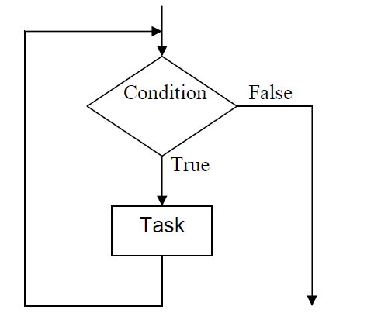
Repetition or Iteration Structure…

Slide 36
The Repeat Until loop.
The syntax is
REPEAT
A statement or block of statements
UNTIL a true condition

Slide 37
The Repeat Until loop.-example
A program segment repeatedly asks for entry of a number in the range 1 to 100 until a valid number is entered.
REPEAT
DISPLAY “Enter a number between 1 and 100”
ACCEPT number
UNTIL number < 1 OR number > 100

Slide 38
The WHILE loop
The syntax is
WHILE (a condition is true)
A statement or block of statements
ENDWHILE

Slide 39
example
A program segment to print out each character typed at a keyboard until the character ‘q’ is entered.
WHILE letter <> ‘q’
ACCEPT letter
DISPLAY “The character you typed is”, letter
ENDWHILE

Slide 40
The FOR Loop
The pseudo-code syntax will be:
FOR (starting state, stopping condition, increment)
Statements
ENDFOR

Slide 41
example
FOR (n = 1, n <= 4, n + 1)
DISPLAY “loop”, n
ENDFOR

Slide 42
Write a program to calculate the sum and average of a series of numbers.
The pseudo-code solution is:
Use variables: n, count of the type integer
Sum, number, average of the type real
DISPLAY “How many numbers do you want to input”
ACCEPT count
SUM = 0
FOR (n = 1, n <= count, n + 1)
DISPLAY “Input the number from your list”
ACCEPT number
SUM = sum + number
ENDFOR
Average = sum / count
DISPLAY “The sum of the numbers is “, sum
DISPLAY “Average of the numbers is “, average

Slide 43
Design an algorithm and the corresponding flowchart for finding the sum of n numbers

Slide 44
Pseudocode Program
Start
Sum = 0
Display “Input value n”
Input n
For(I = 1, n, n-1)
Input a value
Sum = sum + value
ENDFOR
Output sum
Stop

Slide 45
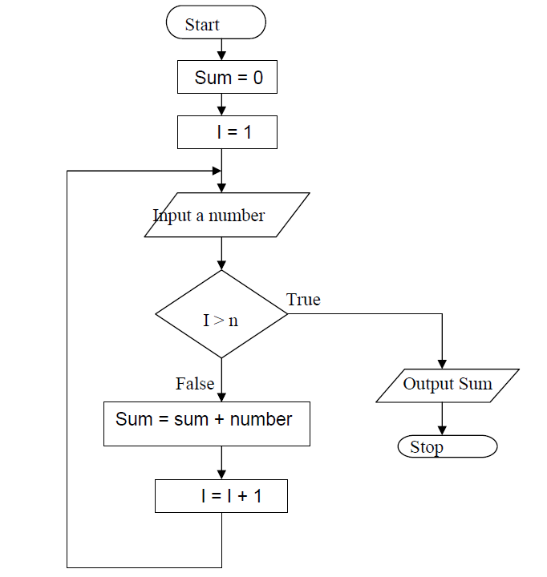

Slide 46
Try
1. Design an algorithm and the corresponding flowchart for finding the sum of the numbers 2, 4, 6, 8, …, n
Write an algorithm and draw a flowchart that will calculate the roots of a quadratic equation
2. Using flowcharts, write an algorithm to read 100 numbers and then display the sum.
4. Write an algorithm to read two numbers then display the smallest
5. Write an algorithm to read three numbers then display the largest.
6. Write an algorithm to read 100 numbers then display the largest

Slide 47
END

